Slide 1



VALENTINE
FOR
NATHANIEL
( H U N )
VALENTINE

Slide 2
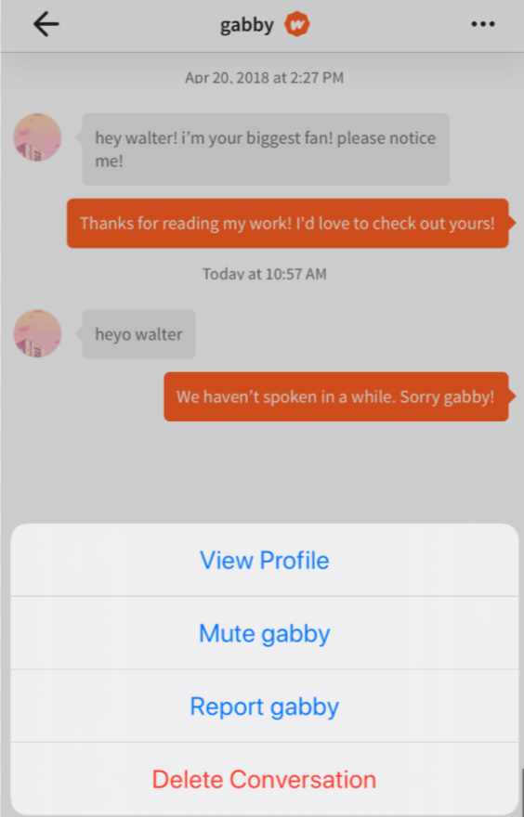



Phoenixtrinity
Phoenixtrinity
Hey!
Hey!
MY FAVOURITE!
VALENTINE
VALENTINE
We’d never expected where a random ‘hey’ on a cringey app could lead us to
View Profile
View Profile
Mute Phoenixtrinity
Mute Phoenixtrinity
Report Phoenixtrinity
Report Phoenixtrinity
Delete Conversation

Slide 3
Here’s
where
it did
take
us to
VALENTINE
VALENTINE

Slide 4
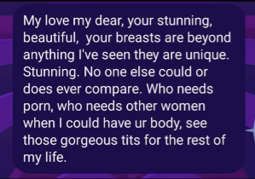
VALENTINE
VALENTINE

Slide 5

VALENTINE
. . .
VALENTINE

Slide 6
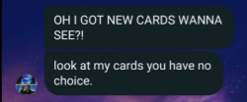
VALENTINE
MTG Cards
VALENTINE

Slide 7
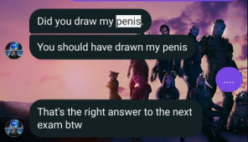
VALENTINE
I doubt if this was the right answer
VALENTINE

Slide 8
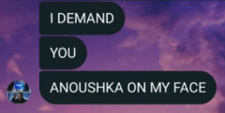
Pervert
VALENTINE
VALENTINE

Slide 9
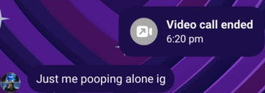
VALENTINE
VALENTINE
The Lonely Poop

Slide 10
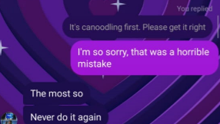
VALENTINE
VALENTINE
“canoodling”

Slide 11
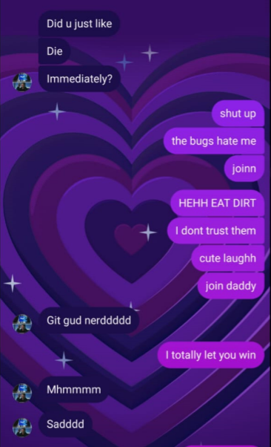
Me introducing you to Stumble Guys and you immediately winning 3 games in a row
VALENTINE
VALENTINE

Slide 12
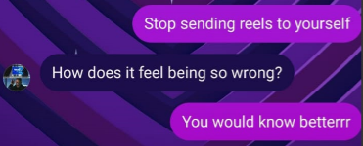
VALENTINE
I’m so savageeeeee
VALENTINE

Slide 13
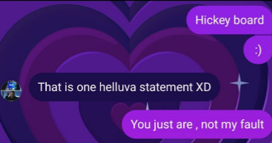
VALENTINE
GETTING HICKEYED IS YOUR PURPOSE
VALENTINE

Slide 14
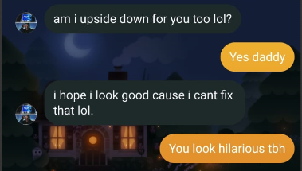
VALENTINE
Upside down guy
VALENTINE

Slide 15
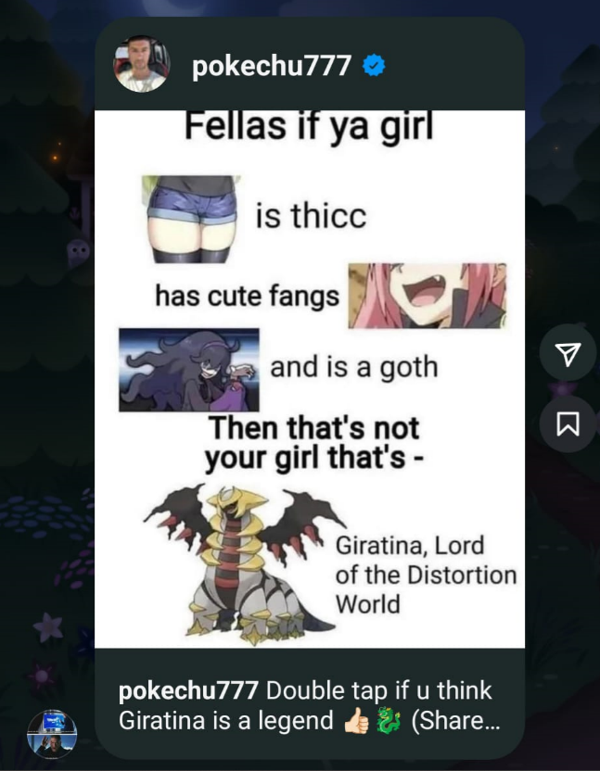
VALENTINE
VALENTINE
Tf is this?

Slide 16
VALENTINE
I love all of this, talking with you, spending time with you, hearing you talk(YAP) about things, and everything you do
SOOOO GLAD TO HAVE YOU
VALENTINE

Slide 17
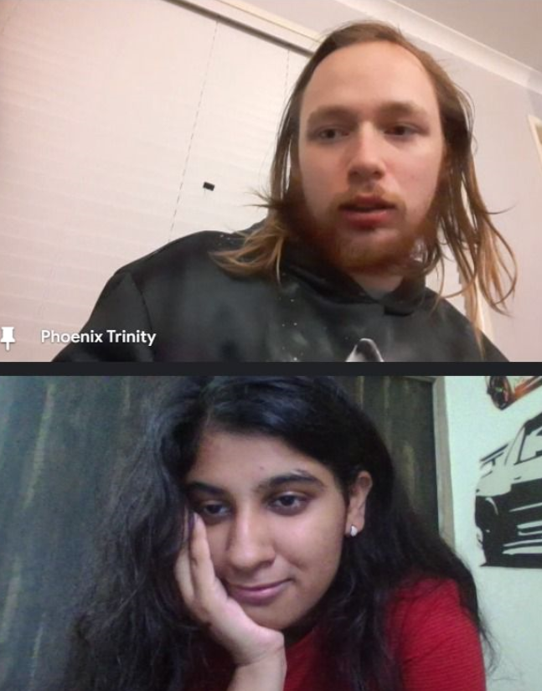
US ON CALL NOW
VALENTINE
VALENTINE

Slide 18
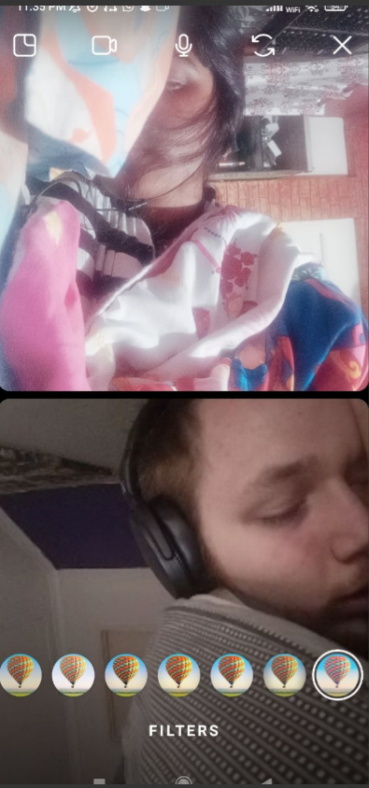
OUR FIRST CALL
VALENTINE
VALENTINE

Slide 19
VALENTINE
Love how far we have come
VALENTINE

Slide 20
VALENTINE
HAPPY
VALENTINE'S
DAY
MY LOVE!
VALENTINE

Slide 21
Thank
You !

Slide 22
btw

Slide 23
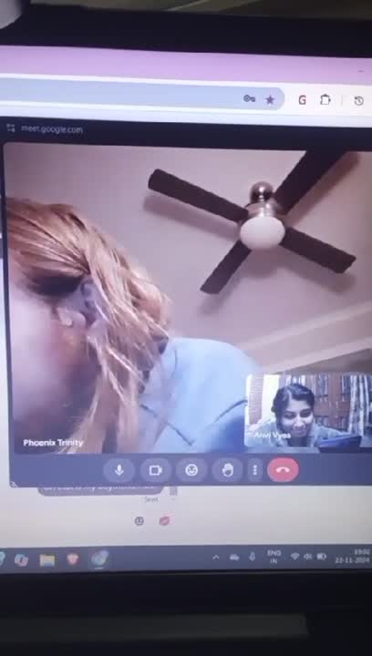
I love making you smile :DD
VALENTINE
VALENTINE

